Slide 1
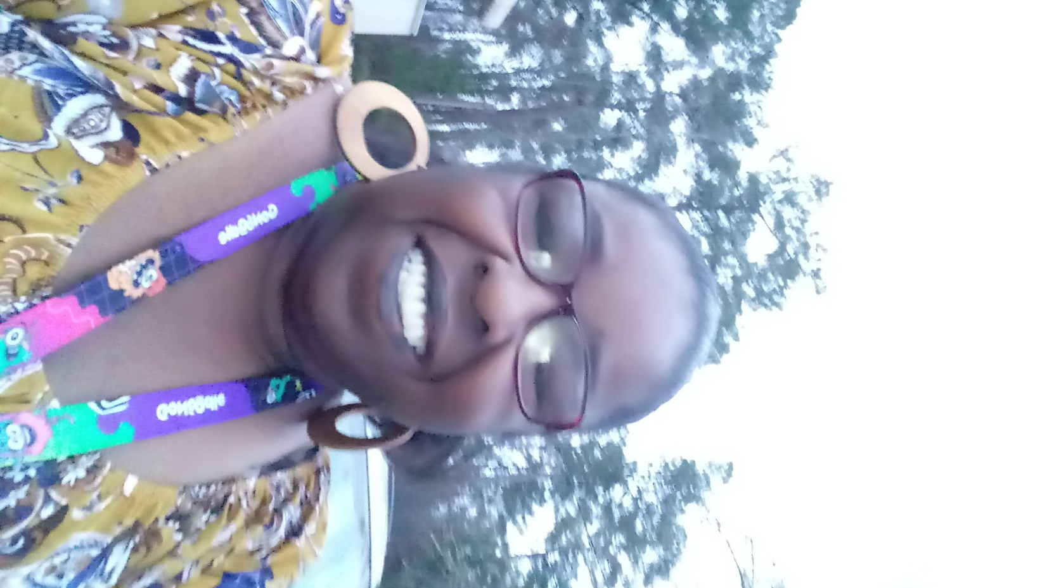
Hello!

Slide 2
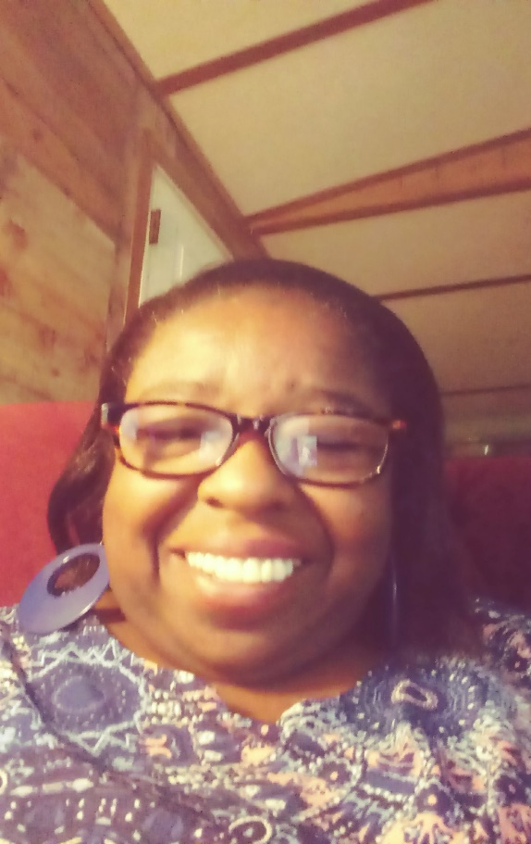
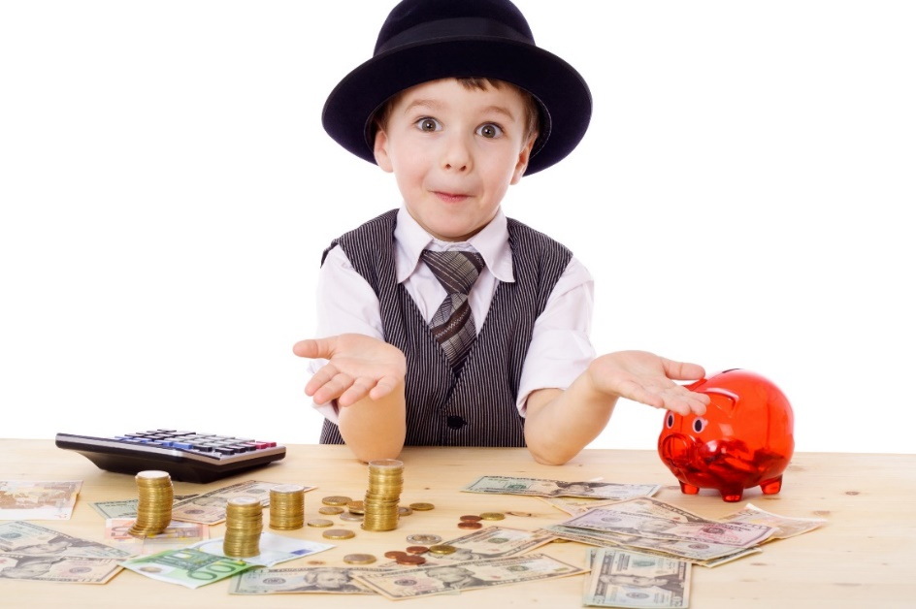
I am Ms. Hemingway, your math teacher this year. I will be teaching 3rd, 4th, and 5th grade. We will engaged in many math experiences that will be connected to real world situations.

Slide 3
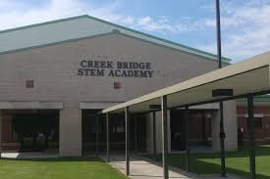
I am so excited to be teaching you here at CBSA.

Slide 4
Here are more things about me.
I was born in NewYork and have lived in my wonderful community, Brittton’s Neck SC for 45 years. I graduated from Britton’s Neck High. I have a B.S in Early Childhood and a Masters in Learning Accommodations. I have attended many professional development courses and workshops over my years of teaching. When I am not teaching my favorite activities are traveling, family gatherings, Youtube tutorials, cooking, researching, shopping, and chatting on the phone with friends. I am a mother, mother-in-law and grandmother.

Slide 5
Here are some things we must all remember at school and away from school.
Wash your hands often
Avoid close contact
Cover your nose and mouth when around others
Cover coughs and sneezes
Clean and disinfect
We Will Do What Is Right!

Slide 6
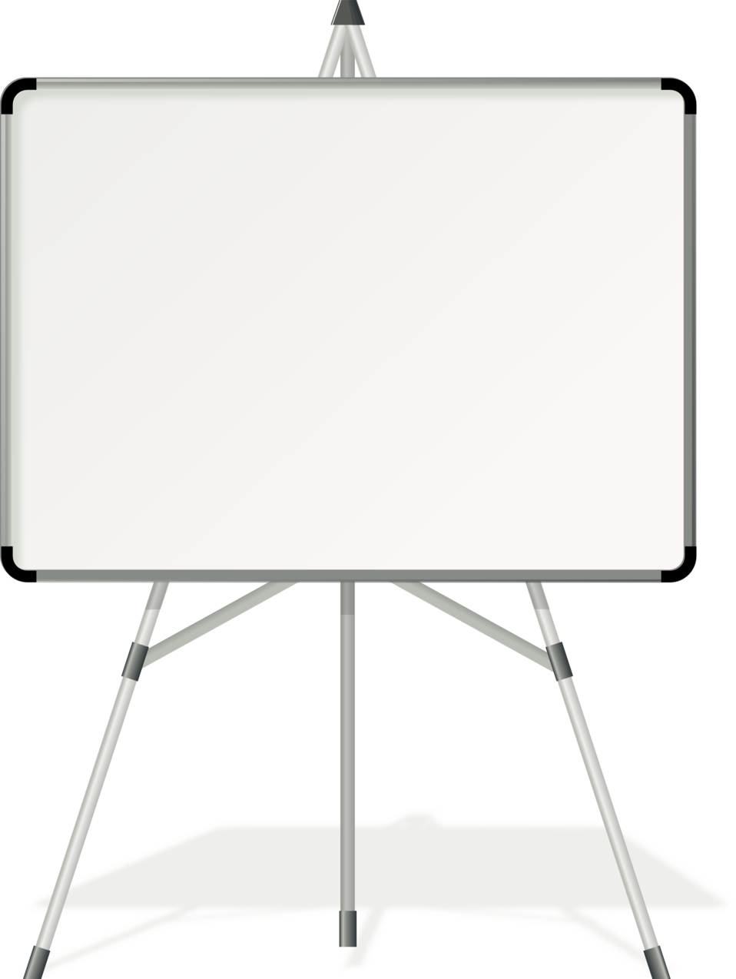
Check my school page for updates, schedule, assignments, etc. Don’t hesitate to contact me. I am here to help students become successful.

Slide 7
